Slide 1
Information Protection
Dec 2018
M4
Microsoft 365 Device Series

Slide 2
Microsoft 365
Empower employees to foster a new culture of work
Unlocks creativity
Built for teamwork
Integrated for simplicity
Intelligent security
Microsoft 365 powered device
Office 365 + Windows 10 + Enterprise Mobility + Security
The best way to deliver Microsoft 365 to your employees.

Slide 3
Agenda
Information Protection
Windows Information Protection
Azure Information Protection

Slide 4
Our Security Offering
Identity & access management
Information protection
Threat protection
Security management
Protect users’ identities & control access to valuable resources based on user risk level
Ensure documents and emails are seen only by authorized people
Protect against advanced threats and recover quickly when attacked
Gain visibility and control over security tools
Azure Active Directory
Conditional Access
Windows Hello
Windows Credential Guard
Azure Information Protection
Office 365 Data Loss Prevention
Windows Information Protection
Microsoft Cloud App Security
Office 365 Advanced Security Mgmt.
Microsoft Intune
Advanced Threat Analytics
Windows Defender Advanced Threat Protection
Office 365 Advanced Threat Protection
Office 365 Threat Intelligence
Azure Security Center
Office 365 Security Center
Windows Defender Security Center

Slide 5
Information Protection

Slide 6
In the past, the firewall was the SECURITY PERIMETER
users
devices
apps
data
On-premises /
Private cloud

Slide 7







Now there’s FEWER BOUNDARIES, more data, more complexity
OPPORTUNITY
On-premises

Slide 8
Microsoft’s approach to INFORMATION PROTECTION
Comprehensive protection of sensitive data throughout the lifecycle – inside and outside the organization
Detect
Classify
Protect
Monitor
Scan & detect sensitive data based on policy
Classify data and apply labels based on sensitivity
Apply protection actions, including encryption, access restrictions
Reporting, alerts, remediation
Devices
cloud
On premises

Slide 9





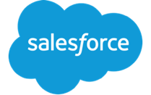

The lifecycle of a sensitive file
Data is detected
Across devices, cloud services, on-prem environments
Data is monitored
Reporting on data sharing, usage, potential abuse; take action & remediate
Data is protected based on policy
Protection may in the form of encryption, permissions, visual markings, retention, deletion, or a DLP action such as blocking sharing
Data is created, imported, & modified across various locations
Data travels across various locations, shared
Protection is persistent, travels with the data
Sensitive data is classified & labeled
Based on sensitivity; used for either protection policies or retention policies
Retain, expire, delete data
Via data governance policies

Slide 10
Detect
Classify
Protect
Monitor
Scan & detect sensitive data based on policy
Classify data and apply labels based on sensitivity
Apply protection actions, including encryption, access restrictions
Reporting, alerts, remediation

Slide 11
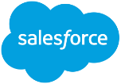



a
CLOUD & SaaS APPS
Detect sensitive information
ON PREMISES
No matter where it’s created, modified or shared
AIP scanner

Slide 12
Detect
Classify
Protect
Monitor
Scan & detect sensitive data based on policy
Classify data and apply labels based on sensitivity
Apply protection actions, including encryption, access restrictions
Reporting, alerts, remediation

Slide 13
Classify information
based on sensitivity
Business-lead policies & rules; configured by IT
Automatic classification
Policies can be set by IT Admins for automatically applying classification and protection to data
Recommended classification
Based on the content you’re working on, you can be prompted with suggested classification
HIGHLY CONFIDENTIAL
CONFIDENTIAL
PERSONAL
Manual reclassification
You can override a classification and optionally be required to provide a justification
GENERAL
PUBLIC
User-specified classification
Users can choose to apply a sensitivity label to the email or file they are working on with a single click

Slide 14
Sensitivity labels persist with the document
Document labeling – what is it?
Metadata written into document files
Travels with the document as it moves
In clear text so that other systems such as a DLP engine can read it
Used for the purpose of apply a protection action or data governance action – determined by policy
Can be customized per the organization’s needs
FINANCE
CONFIDENTIAL

Slide 15
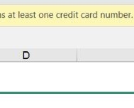
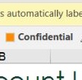
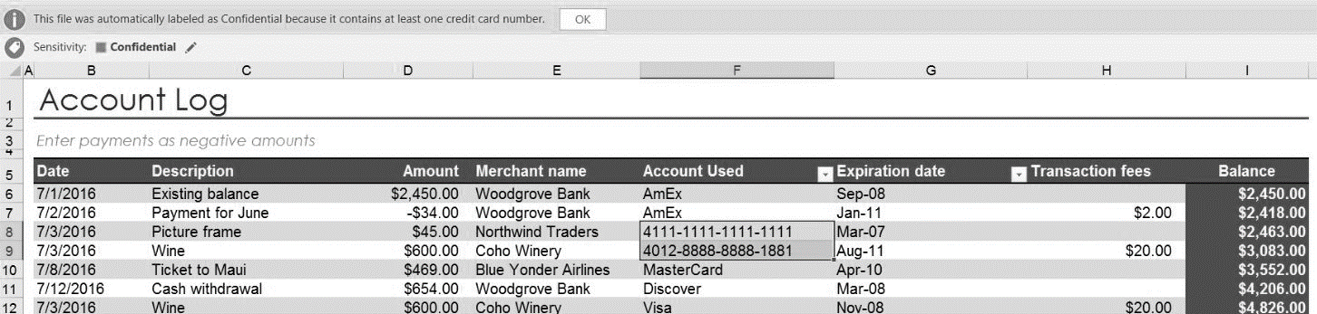
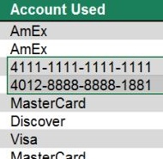
Classification & labeling example – sensitive data
Discover personal data and apply persistent labels
Labels are persistent and readable by other systems e.g. DLP engine
Label is metadata written to data
Sensitive data is automatically detected
Notes:
MICROSOFT CONFIDENTIAL at the bottom of this slide is just a slide master included here. Click on View – Slide Master – and the footer to remove…

Slide 16

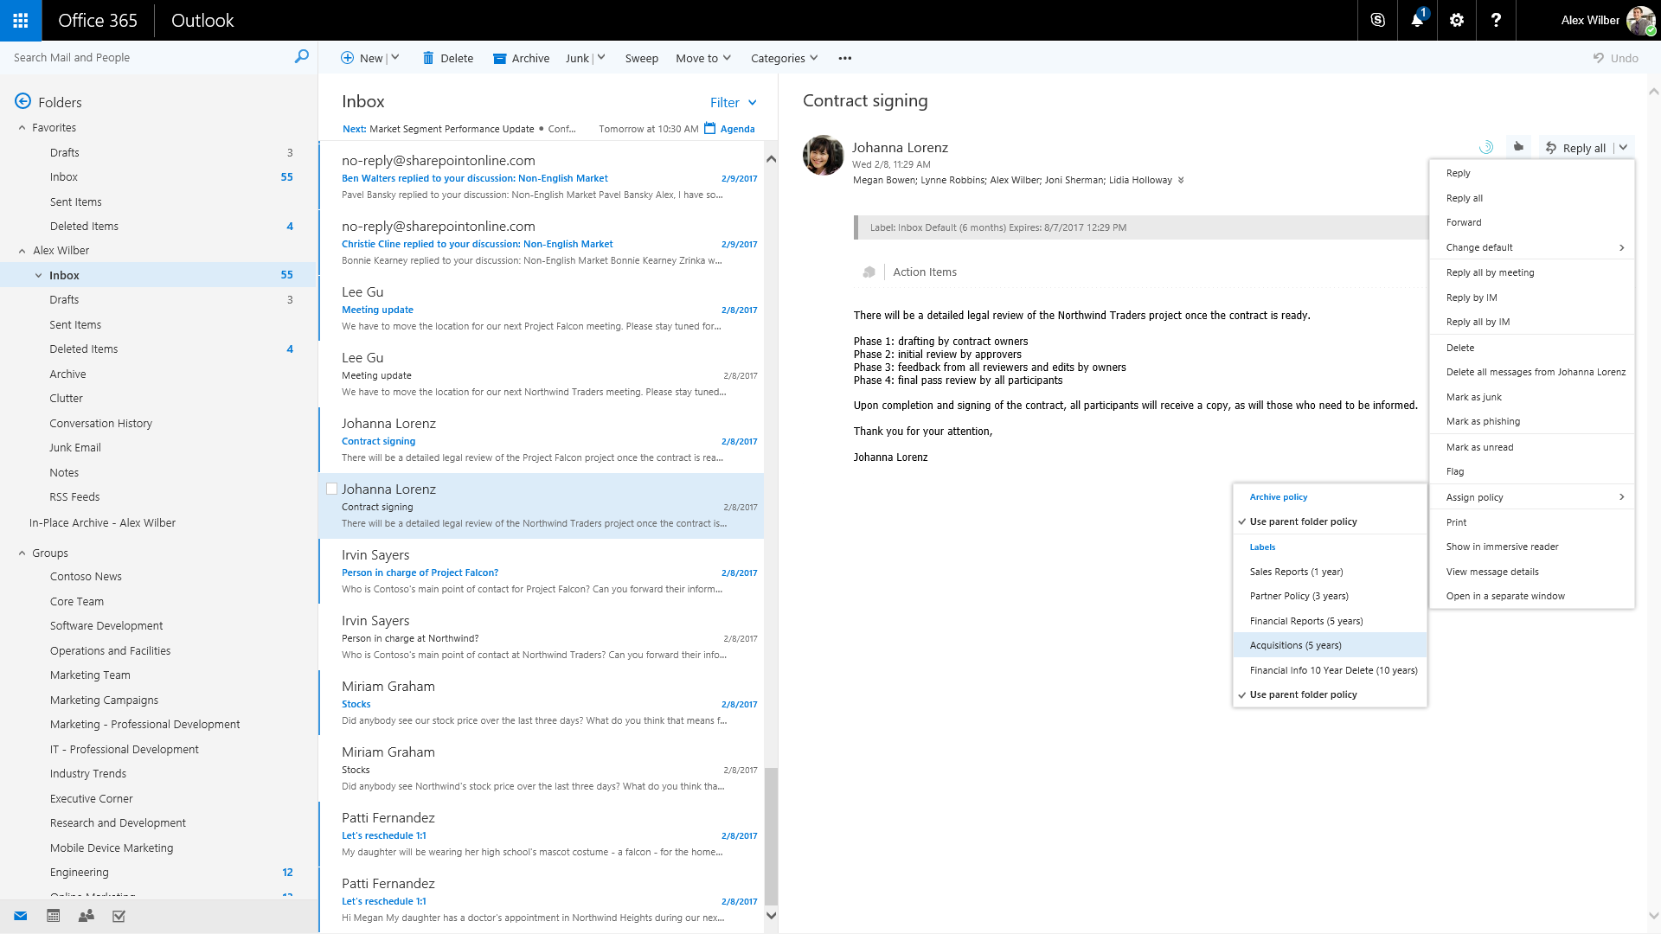
Classification & labeling example – data governance
Labeling can be end-user driven or automatically applied

Slide 17
Microsoft’s information protection solutions
Comprehensive protection of sensitive data across devices, cloud services and on-premises environments
Devices
OFFICE 365
CLOUD SERVICES, SaaS APPs & ON-PREMISES
PCs, tablets, mobile
Exchange Online, SharePoint Online & OneDrive for Business
Highly regulated
Azure
3rd-Party SaaS
Datacenters, file shares
MAM, Windows Information Protection & BitLocker for Windows 10
Office 365 DLP
Office 365 Advanced Data Governance
Intune MDM & MAM for iOS & Android
Azure Information Protection
Microsoft Cloud App Security

Slide 18
Detect
Classify
Protect
Monitor
Scan & detect sensitive data based on policy
Classify data and apply labels based on sensitivity
Apply protection actions, including encryption, access restrictions
Reporting, alerts, remediation

Slide 20
Protect sensitive data across your environment
Cloud & on-premises
File encryption
Permissions and rights-based restrictions
DLP actions to prevent sharing
Policy tips & notifications for end-users
Visual markings in documents
Control and protect data in cloud apps with granular policies and anomaly detection
Data retention, expiration, deletion
Devices
Drive encryption
Remote wipe
Business data separation

Slide 21

Protect information on lost or stolen devices
Device encryption
Drives in devices are easily encrypted can not be accessed by unauthorized users when a device is lost or stolen
Removable storage encryption
Encrypt information on removable storage devices, such as a USB drive
Remote wipe
Delete data on devices – on demand

Slide 22

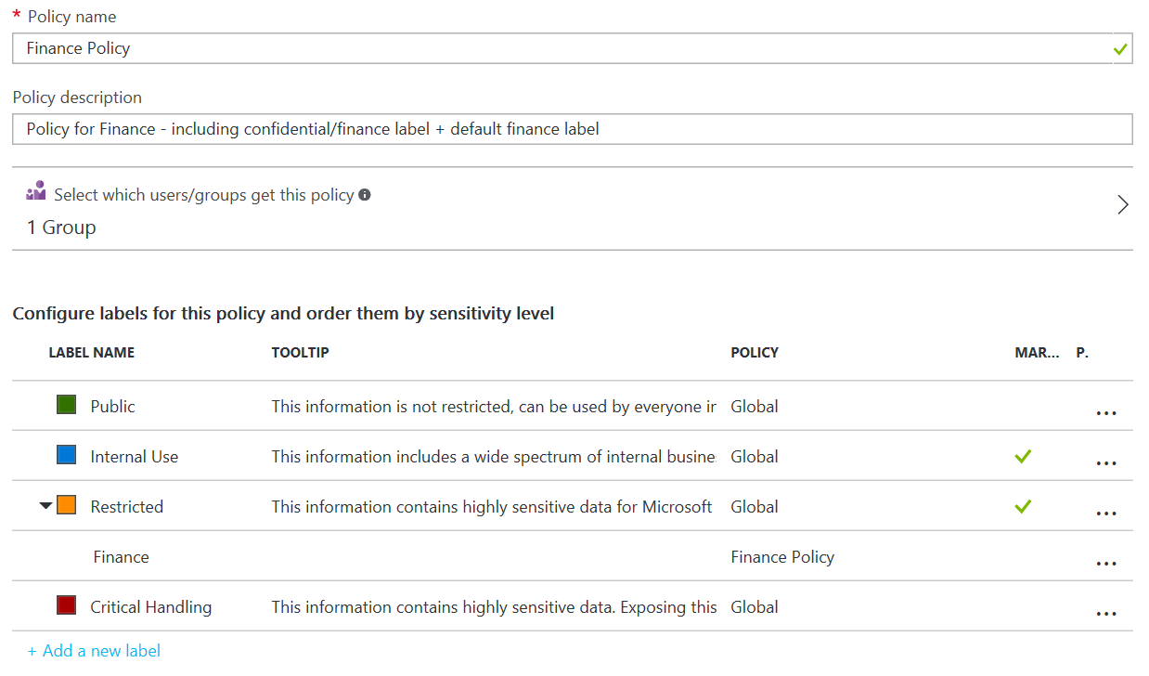
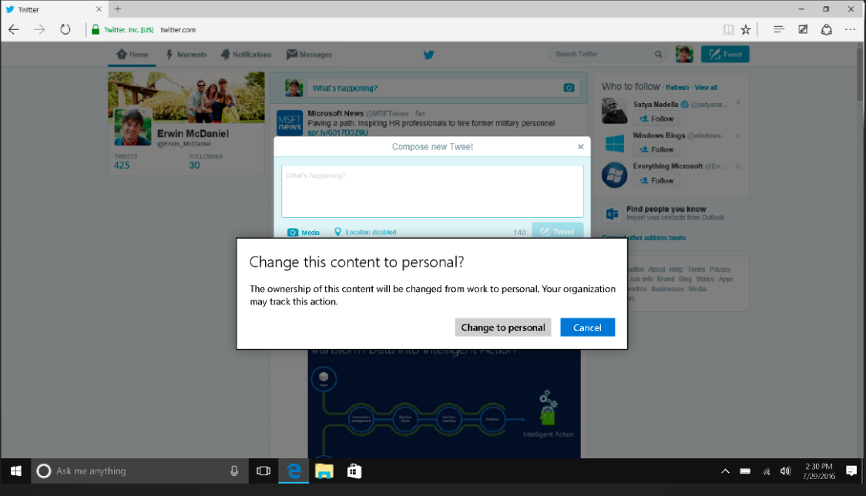
Protect business information on Windows 10 devices
Separation and containment of business information
Prevents accidental leaks by automatically separating and containing business information
Business-lead policies & IT stays in control
Policies enable IT to define which apps and users are authorized to access business information as well as the rights users have when using it (e.g.: copy and paste)
Easy for end users
Built directly into Windows and works behind the scenes – only notifying users when they’re attempting to take unauthorized actions

Slide 23


Protect sensitive information across cloud services & on premises
Data encryption built into Azure & Office 365
Revoke app access
File-level encryption and permissions
Policy tips to notify and educate end users
DLP actions to block sharing
Visual markings to indicate sensitive documents
Control cloud app access & usage
Retain, expire or delete documents

Slide 24
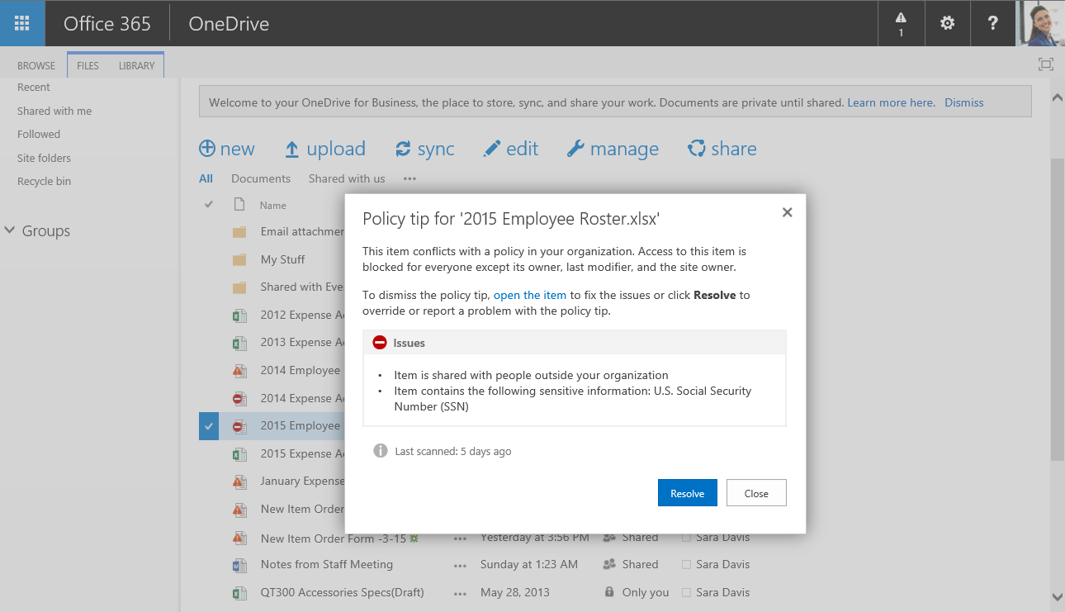
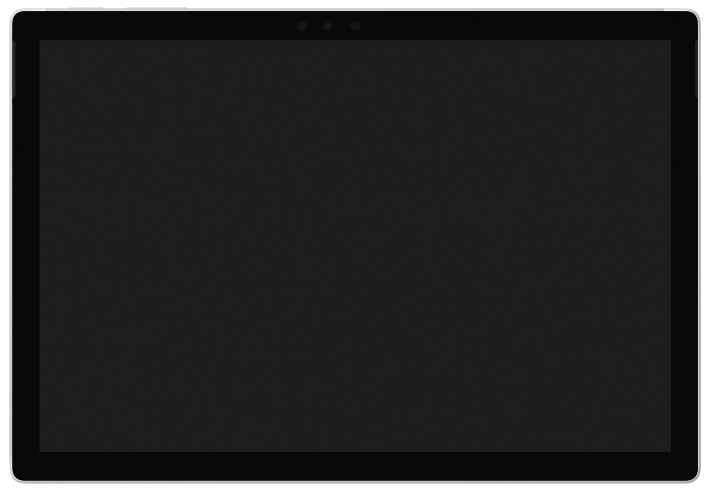
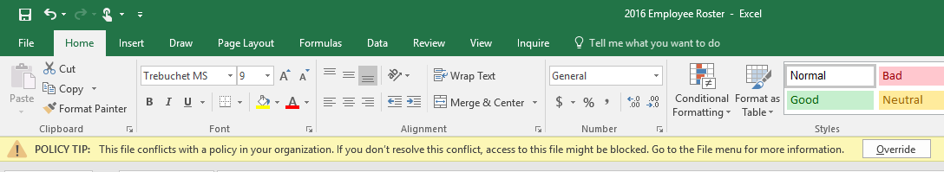
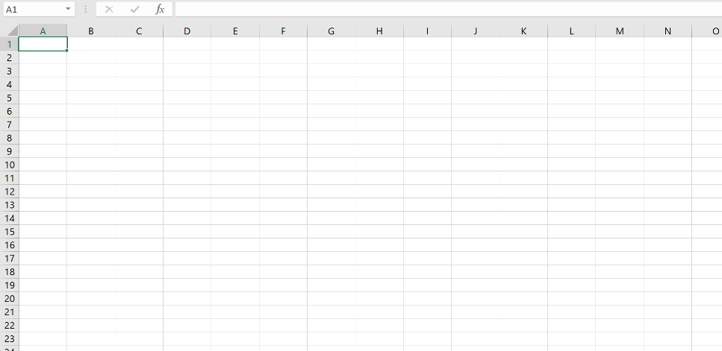

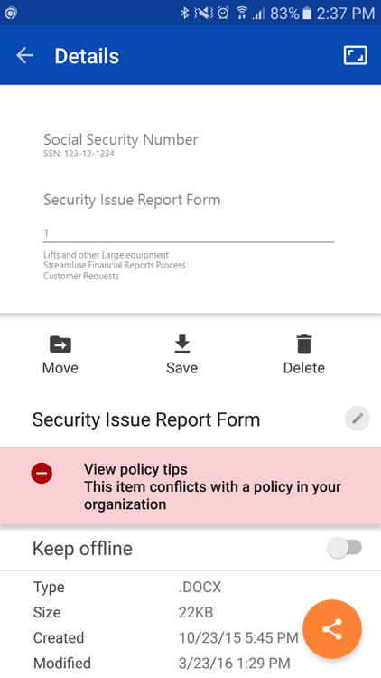
Protection example:
DLP policy to limit document sharing
Across Office client applications – mobile, desktop & tablets
Policy tips to warn end users
Restrict or block sharing – internally or externally

Slide 25


Protect data in CLOUd Apps with cloud app security
Granular data loss prevention (DLP) policies
Set granular policies to control data in the cloud—either automated or based on file label—using out-of-the-box policies or you can customize your own
Policy enforcement
Identify policy violations, enforce actions such as quarantine and permissions removal
Understands classification & labeling
Reads classification and labeling in the document – so you can gain visibility into sharing of sensitive files and create policies
Revoke access for 3rd party apps
Detect and manage 3rd party app access

Slide 26
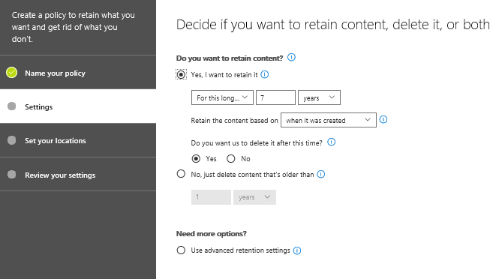
Automatically retain and delete documents in Office 365 with data governance
Retention
Retain content in sites, mailboxes, and public folders indefinitely or for a specific duration
In-place
Data remains in its original location in Office 365 and users can continue to work with their documents or mail, but a copy of the content as it existed when you initiated the policy is preserved
Delete data
A retention policy can both retain and then delete data, or simply delete old data without retaining it

Slide 27
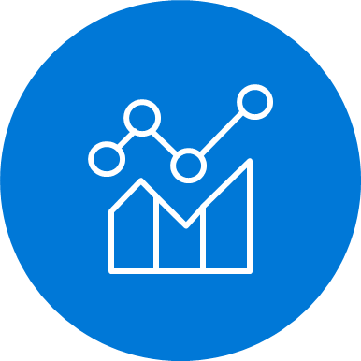
Detect
Classify
Protect
Monitor
Scan & detect sensitive data based on policy
Classify data and apply labels based on sensitivity
Apply protection actions, including encryption, access restrictions
Reporting, alerts, remediation

Slide 28

Monitor information protection events for greater control
Visibility
Policy violations
Document access & sharing
App usage
Anomalous activity
End-user overrides
False positives
Take Action
Tune & revise policies
Revoke access
Quarantine file
Quarantine user
Integrate into workflows & SIEM

Slide 29
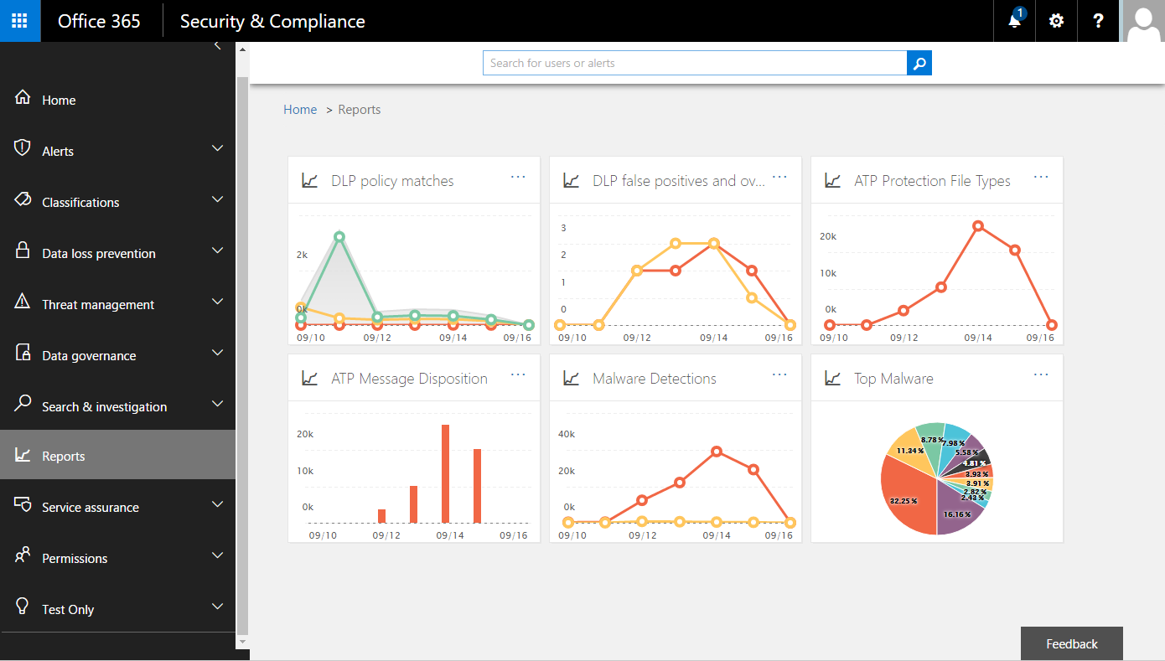
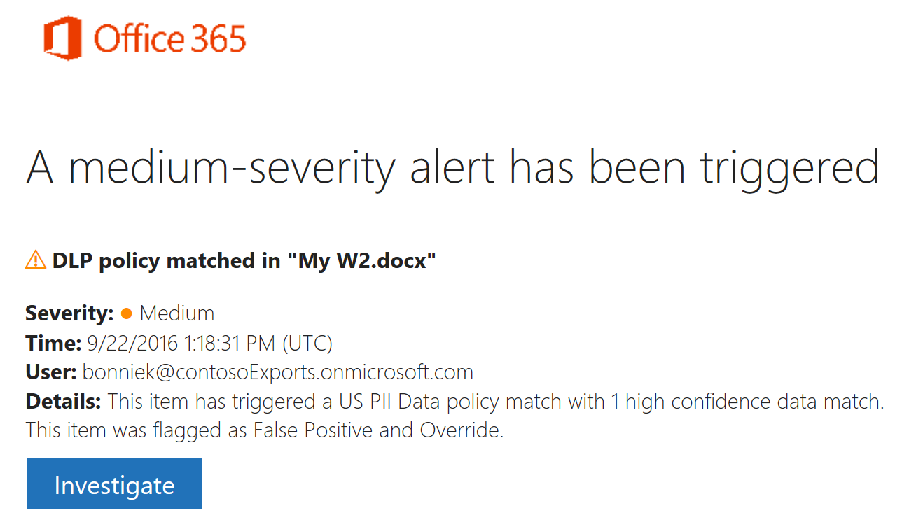
Monitor DLP and data governance events
Know when policy is violated
Incident report emails alert you in real time when content violates policy
See the effectiveness of your policies
Built in reports help you see historical information and tune policies
Integrates with other systems
Leverage the Activity Management API to pull information into SIEM and workflow tools

Slide 30
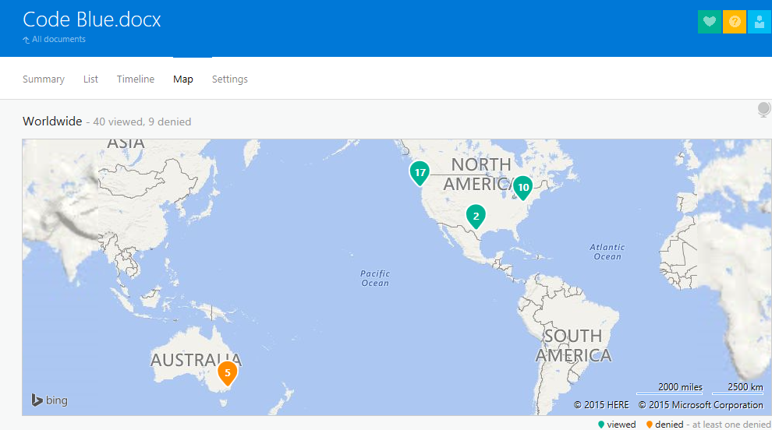
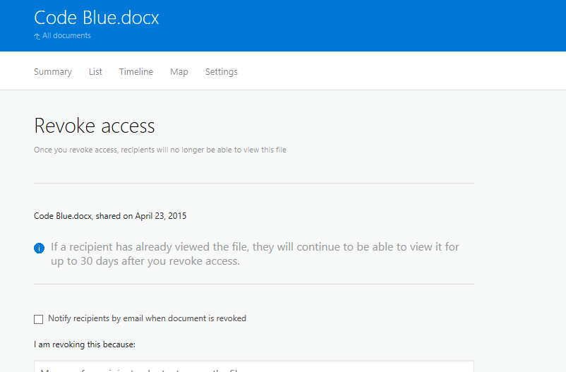
Monitor document sharing & access
Distribution visibility
Analyze the flow of personal and sensitive data and detect risky behaviors.
Access logging
Track who is accessing documents and from where.
Access revocation
Prevent data leakage or misuse by changing or revoking document access remotely.

Slide 31
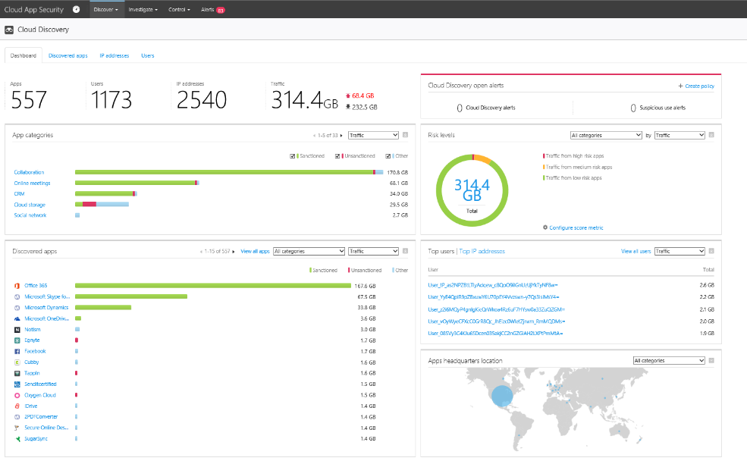
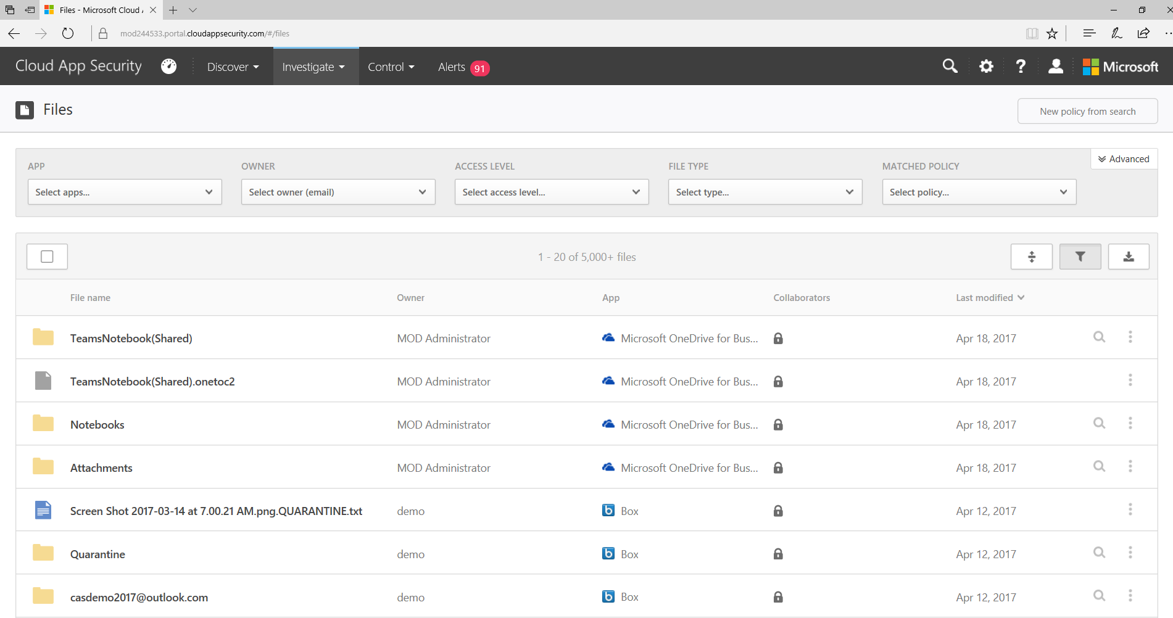
Monitor cloud app usage
Advanced incident investigation tools
Investigate on users, file, activities, locations and managed apps, quantify exposure and risk
Cloud data visibility
Identify how data – both classified and not classified – is shared across cloud apps and identify risk
Cloud app risk assessment
Assess risk cloud apps based on ~60 security and compliance risk factors.
On-going analytics & anomaly detection
Get anomalous usage alerts, new app and trending apps alerts

Slide 32
Labs
Lab 8 - AIP & WIP Consolidated
https://m365.learnondemand.net
Notes:
Refer to lms.learnondemand.net for instructor access to labs
Labs Security
Introduction to Hands On Labs
Deploy Windows Hello for Business
Deploy Credential Guard
Prevent Ransomware with Device Guard
Configure Conditional Access with AAD, Intune and Office 365
Configure Azure Information Protection
Protect Apps with Microsoft Intune Mobile Application Management
Deploy Windows Information Protection
Consolidate Windows and Azure Information Protection
Configure Systems to Meet Governance Standards
Prepare for General Data Protection Regulation Compliance
Analyze and Mitigate Security Threats and Windows Defender ATP
Protect Office Documents with Microsoft Office 365 ATP
Protect Cloud Apps with Microsoft Cloud App Security
Protect Users and Devices with Microsoft Advanced Threat Analytics

